Slide 1
The Finnish Innovation System
t
Linkages between academy and industry
Tekes
Raine Hermans, PhD, Adj. Prof.
Director, Strategic Intelligence

Slide 2
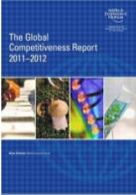
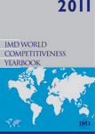
Competitiveness
Total ranking 2011-2012
WEF
Global
competitiveness
IMD
Total
competitiveness
2011
2010
2011
Switzerland
Singapore
Sweden
USA
Germany
Netherlands
Denmark
Japan
Great Britain
Hong Kong
Canada
Taiwan
Qatar
Belgium
Norway
1
2
3
5
6
7
8
9
10
11
12
13
14
15
16
1
3
2
4
5
8
9
6
12
11
10
13
17
19
14
5
3
4
1
10
14
12
26
20
1
7
6
8
23
13
Finland
4
7
15
Sources: WEF, The Global Competitiveness Report 2011-2012 and IMD World Competitiveness Yearbook 2011
Notes:
IMD: World Competitiveness Yearbook 2009
http://www.imd.ch/research/publications/wcy/index.cfm
WEF: The Global Competitiveness Report 2010-2011
http://www.weforum.org/en/initiatives/gcp/Global%20Competitiveness%20Report/index.htm

Slide 3
Innovation and competitiveness
Finland was ranked second with R&D input and personnel, venture capital, productivity and trade indicators.
Source: The Information Technology and Innovation
Foundation ITIF; The Atlantic Century II, Benchmarking EU & US, Innovation and competitiveness

Slide 4
Science and innovation profile of Finland
Finland is a pioneer in many aspects of innovation activities.
Source: OECD Science, Technology and Industry Outlook 2010.
Notes:
www.oecd.org/sti/outlook 11.01.2011
Data/Exceltaulukko: http://dx.doi.org/10.1787/888932333633

Slide 5
Resources in the innovation environment
R&D
at companies
4,179*
Private
Business
Angels
Approx. 380*
From abroad
407***
Venture capitalists:
Private 364
Finnish Industry Investment:
direct 19, venture capital funds 131,
seed funding 7
VTT
245 (74)
Finnvera
468 (44)
Tekes
526 (526)
Sitra
35
Academy
of Finland
297 (297)
Finpro
35 (21)
Ministries,
ELY Centres,
sectoral research
413 (402)*
Innofin
7 (5)
Universities and
polytechnics**
1,165 (482)
Public
Business development
Marketing
Internationalisation
Basic research
Applied research
Business R&D
The figures represent the total extent of each organisation in million euros in 2008, those marked
with star are earlier. In parenthesis the share that is funded from the State budget.
**includes polytechnics *** includes R&D costs of corporations foreign units
Notes:
5

Slide 6
Public sector activities of R&D in Finland
PARLIAMENT
Research and
Innovation
Council
GOVERNMENT
Ministry of
Education and
Culture
Ministry of
Employment
and the
Economy
Other
ministries
and their
institutes
Academy of
Finland
Tekes
Sitra
Finnvera plc
Finpro
Finnish
Industry
Investment Ltd
Universities
VTT
Regional
ELY Centres
Notes:
6

Slide 7
Examples of various dimensions of Tekes role (based on innovation boundaries defined in energy and environmental technology programs)
(VTT Sfinpact analysis, 2012)
Networking dimension
Networker
In R&D funding schemes, also other ´add value´ networking services (seminars, workshops, FiDiPro, etc.)
Geographical dimensions
Local, regional, national, global actor
Coordination dimension
Coordinator
Of applied national S&T via technology programs and other activities
Combination dimension
Creator and networker
of various new technology and expertise areas & related firms in order to create new combinations in frontier areas of traditional S&T areas in technology programs and other activities
Financial dimension
Funder & networker
R&D funding on condition customers in research & industrial communities will network mutually -- via this role several various roles via different dimensions
Innovation process dimension
Various promoting roles in different stages of innovation processes
Generic STI dimension- Penetrator and accelerator
Of applications of new generic technologies to companies in various industrial fields
Future dimension
Forsighter & visioner of STI
Development, e.g. FINNSIGHT, NISTEP study, Megatrends, etc. (a lot of potential, foresight used only in 16 % of technology programs
Enhancer of national S&T level Enhancer of applied STI level
Via most programs, some of them particularly intended to raise national scientific level (Biodiversity, FINE)
Source: (VTT Sfinpact analysis, 2012)

Slide 8
Finland is the leading country regarding innovation cooperation between companies and academia – Tekes plays a significant role in creating these partnerships
Innovation cooperation between companies, universities and
research organisations
%
Share of innovating companies 2008–2010
Source: Eurostat, Community Innovation Survey
Notes:
8
Linkki: http://www.stat.fi/artikkelit/2011/art_2011-04-04_002.html?s=3

Slide 9
Crossing boundaries: Tekes funding for large companies is channelled to research organisations and SMEs
Average funding flows in 2008-2010
Funding flows, million euros
Tekes funding for large companies
Large companies projects buy research
services from universities and research
institutes
Large companies projects use SMEs as
subcontractors
Large companies co-finance public
research projects in universities and
research institutes
Net flow
Large company
over 500 employees
+ 58
- 28
- 19
- 10
+ 1
10mill. €
University
Research
institute
Costs of projects
funded by Tekes
167 mill. €
28 mill. €
19 mill. €
SMEs
58 mill. €
Tekes
Figures do not include funding of large companies through SHOKs.
Research programmes of the Strategic Centres for Science,
Technology and Innovation (SHOK) are joint programmes for
research organisations and companies.

Slide 10
Monetary Value Flows between Nokia and Public Sector in Finland 1995-2000 (in 2000 prices)
Public sector
Tekes 0.08 billion €
Public expenditure and income transfers without employment expenditure 1.6 billion €
Corporate Taxes 2.9 billion €
Wage taxes 1.4 billion €
Social insurance fees 1.2 billion €
Taxes due to options 1.2 billion €
Nokia
1.7 billion €
6.7 billion €
Nokia’s investments in the universities 0.02 billion €
”Replacement value” of the formal education 0.6 billion €
Universities
Source: Statistics Finland, Nokia, Ministry of Education, ETLA.

Slide 11
Nokia’s cooperation network in Tekes ETX and TLX Programmes

Slide 12
Tekes R&D funding in 2011
Total 610 million euros and 1,928 projects
Grants in projects launched by municipalities, cooperatives, societies and associations
10 million euros
R&D grants
to companies and
public organisations
215 million euros
Research funding
for universities,
research institutes
and polytechnics
203 million euros
R&D loans to companies
101 million euros
The funding for R&D includes 18 million euros from EU Structural Funds.
Research programmes of the Strategic Centres for Science, Technology and Innovation (SHOK) are joint programmes for research organisations and companies.
Notes:
12
12

Slide 13
About Tekes
Our services
Tekes offers risk funding for research and innovation projects.
For young (< 6 years) companies, funding is available for all aspects of business development.
Customers
Tekes funding is primarily targeted for forerunners and particularly challenging projects:
  Finnish companies and subsidiaries of multinational companies located in Finland – some 5,000 active customers.
  Universities & research institutes – most Finnish research teams in life sciences and engineering are Tekes customers.
Resources
Budget: In 2012, €554 million from the state budget
Personnel: 370 in Finland and abroad (China, EU, Japan, USA)

Slide 14
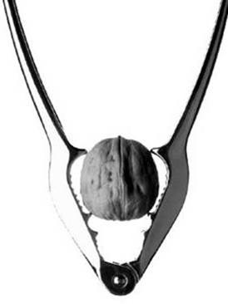
Tekes aims to
build a strong networked knowledge base
renew the economy and create new businesses
increase productivity in industries
and service sector
enhance wellbeing in society and
improve environmental sustainability

Slide 15
Following up the Customers Results: Productivity of SMEs
Firms funded by Tekes in 2001 (2001 = 100)
Total development (weighted mean)
Firms funded by Tekes
Total population
Counterparts –no Tekes
funding
Source: Etlatieto Oy (2012)

Slide 16

Growth companies are the most important target group for Tekes
Young, innovative companies which are
involved in the Tekes
funding programme and
seek fast growth increased their turnover from 10 million euros to 250 million euros in four years during the recession.
Notes:
Uutinen VTT:n SfinPact-selvityksen tuloksista
http://www.tekes.fi/fi/community/Uutiset/404/Uutinen/1325?name=Tekesilla+merkittava+vaikutus+innovaatioihin
SfinPact-loppuraportti: Tekes Review 289/2012: Funder, activator, networker, investor http://www.tekes.fi/u/Funder_activator_networker_investor.pdf
Tekes tiedottaa 16.2.2012
Tekesillä merkittävä vaikutus innovaatioihin
Tekes on ollut rahoittamassa yli 60 prosenttia suomalaisista yleisesti tunnetuista innovaatioista. Näistä 80 prosentissa Tekesin rooli on ollut merkittävä.
Innovaatio on uusi tuote, palvelu tai toimintatapa, joka tuottaa taloudellista tai yhteiskunnallista hyötyä. VTT:n laatima selvitys osoittaa, että Tekesillä on ollut merkittävä rooli erityisesti uutuusarvoltaan suurien ja kansainvälisille markkinoille tähtäävien uusien innovaatioiden synnyssä. Usein tällaisten haasteellisten innovaatioiden syntyyn liittyvä kehitystyö vaatii myös pitkän ajan.
”Innovaatioiden syntyminen on tässä ajassa erityisen tärkeää, sillä ne takaavat Suomen kilpailukyvyn ja menestyksen myös tulevaisuudessa”, kertoo Tekesin pääjohtaja Veli-Pekka Saarnivaara.
SfinPact-raportti perustuu noin 5 000 suomalaisen innovaation Sfinno-tietokantaan. Tarkastellut innovaatiot olivat vuosilta 1985–2007.
VTT:n keräämä Sfinno on maailmanlaajuisesti ainutlaatuinen innovaatiotietokanta, joka mahdollistaa suomalaisen innovaatiotoiminnan ja -politiikan tutkimisen vuosikymmenten ajalta. Tulokset perustuvat edustavaan otokseen, jossa lähes tuhat innovaatioiden toteuttajaa vastasi kyselyyn.
”Yhteiskunnallinen vaikuttavuus ja sen läpinäkyvä tarkastelu ovat tärkeä osa Tekesin vastuullisuutta. On tärkeää, että suomalaiset tietävät, mitä Tekes tekee ja mitkä ovat sen toiminnan vaikutukset”, sanoo Veli-Pekka Saarnivaara.
Raportti avaa innovaatiotarinoita peleistä bioetanoliin
Selvityksen mukaan Tekesillä on ollut merkittävä rooli rahoituksen lisäksi tutkimus- ja kehittämistoiminnan aktivoijana sekä yliopistojen, tutkimuslaitosten ja yritysten verkottajana. Tekes on vaikuttanut kokonaisten toimialojen, kuten esimerkiksi terveyteen liittyvien biomateriaalien tai pelialan, kehitykseen.
Tekesin roolien lisäksi raportissa pureudutaan seitsemän toimialan kehityksen ja innovaatioiden kuvaamiseen. Siinä esitellään myös monien menestyneiden innovaatioiden tarinat. Sellaisia ovat mm. Rovion Angry Birds, Raision Benecol, St1:n bioetanoli ja Polar Electron rannetietokoneet.

Slide 17
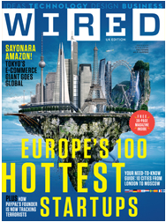

The start-up companies funded by Tekes grow fast and successfully
Wired Magazine ranked the hottest start-up companies in Europe in 2012. Tekes has provided funding for all the Finnish companies mentioned on the ranking list:
Ovelin
Kiosked
Tinkercad
Audiodraft
Grand Cru
Mendor
Powerkiss
Steam Republic
Thirdpresence
Grey Area (also ranked high in 2011)
43 out of the top 50 companies on the Deloitte Technology Fast 50 Finland ranking list have received funding from Tekes, among them the ten fastest growing companies:
Confidex Oy (5,513 %)
Snoobi Oy (4,652 %)
Analyse² (4,068 %)
Uoma Oy (3,015 %)
Klikkicom Oy (2,308 %)
Sympa Oy (2,177 %)
OptoFidelity Oy (1,738 %)
Endero Oy (1,548 %)
Netvisor Oy (1,532 %)
Beneq Oy (1,090 %)
(in parentheses the increase
in turnover over five years)
Notes:
Wired-lehden artikkeli
http://www.wired.co.uk/magazine/archive/2011/09/start/letter-from-the-editor
Tekesin uutinen Wired-lehden listauksesta 16.8.2011:
http://www.tekes.fi/fi/community/Uutiset/404/Uutinen/1325?name=tekesin+rahoittamat+yritykset+valloittivat+wiredlehden+listan
Deloitte Technology Fast 50 Finland 2011
http://www.deloitte.com/view/fi_FI/fi/ajankohtaista/technology_fast_50500/2011-Technology-Fast-50-500/index.htm
Tekesin uutinen Deloitten julkistuksesta 8.11.2012: Tekes vauhdittaa yritysten kasvua
http://www.tekes.fi/fi/community/Uutiset/404/Uutinen/1325?name=Tekes+vauhdittaa+yritysten+kasvua

Slide 18
Our approach
Tekes complements private financiers
we accept more risks than private financiers, if risks are comparable to business potential
we address market failure related to availability of private seed and start-up funding
we do not take equity in the companies that we finance
all intellectual property created in Tekes funded projects belongs to companies and research organizations that receive funding
our funding does not imply that the company receiving funding has to locate its manufacturing in Finland
Confidentiality
Tekes does not disclose business confidential information to third parties
applications from companies and research organizations are evaluated in-house by experts with first-hand business experience

Slide 19
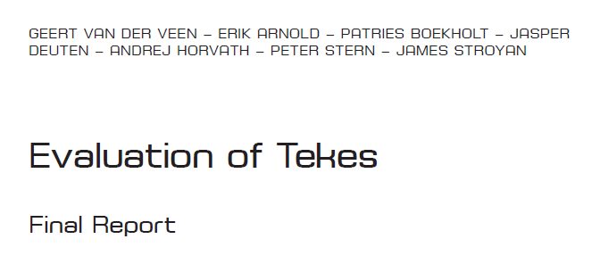
“Tekes has performed well and is among the world’s leading innovation agencies”

Slide 20
Finnish innovations, the VTT SFINNO database
Consists of about 4,900 innovations developed by Finnish companies, dating back to 1945.
Updated every other year by identifying innovations in field publications. This object-oriented approach is complemented by sending a questionnaire to the innovator.
Further information:
http://www.vtt.fi/proj/sfinno
Tekes Review 289/2012: Funder, activator, networker, investor
Innovation Interstate

Slide 21
Significance of Tekes funding for Finnish innovations, 1985-2007
Source: VTT Sfinno- database, questionnaire, n = 960
DM 915541
02-2012

Slide 22
Significance of Tekes funding for Finnish innovations that are new to global markets, 1985-2007
Source: VTT Sfinno- database, questionnaire, n=613
DM 915541
02-2012

Slide 23
Significance of Tekes funding for Finnish innovations based on scientific breakthroughs, 1985-2007
Source: VTT Sfinno- database, questionnaire, n=194
DM 915541
02-2012

Slide 24
Duration of innovation development and significance of Tekes funding
Lähde: VTT SFINNO™ -tietokanta, 1985 - 2007. Huomio: lukemat perustuvat kyselyvastauksiin.
Source: VTT SFINNO™ -database, 1985 - 2007 (N = 852). Note: The figures are based on survey responses.

Slide 25
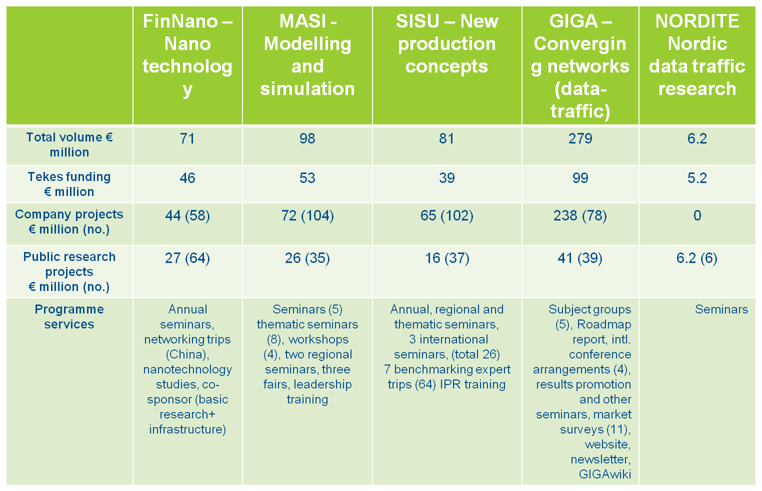
Programmes: Tekes programmes that ended in 2010
Programmes published in the final and evaluation reports
Notes:
25

Slide 26
Radical innovations: breakthrough from local value chains to global value networks
Multidisciplinary competences of many kinds (enabling systemic changes)
Measuring cross-disciplinarity
of competences
Portfolio of radical innovations which are based on systemic changes in global value networks → orchestrating
complex entities (incl. regulation)
Risk and return increase along with
development of systemic and
multidisciplinary innovations which
are facilitated and supported by
public funding
Plug
&
Play
innovation
Systemic innovation
(modifying operational
environment)
→ Cost-benefit analyses of the entire system
Modified from: Kristian Möller, Aalto University School of Economics (2010)
Portfolio of
Incremental innovations,
which are based on conventional
value chains) → managing projects
No cross-disciplinary competences

Slide 27
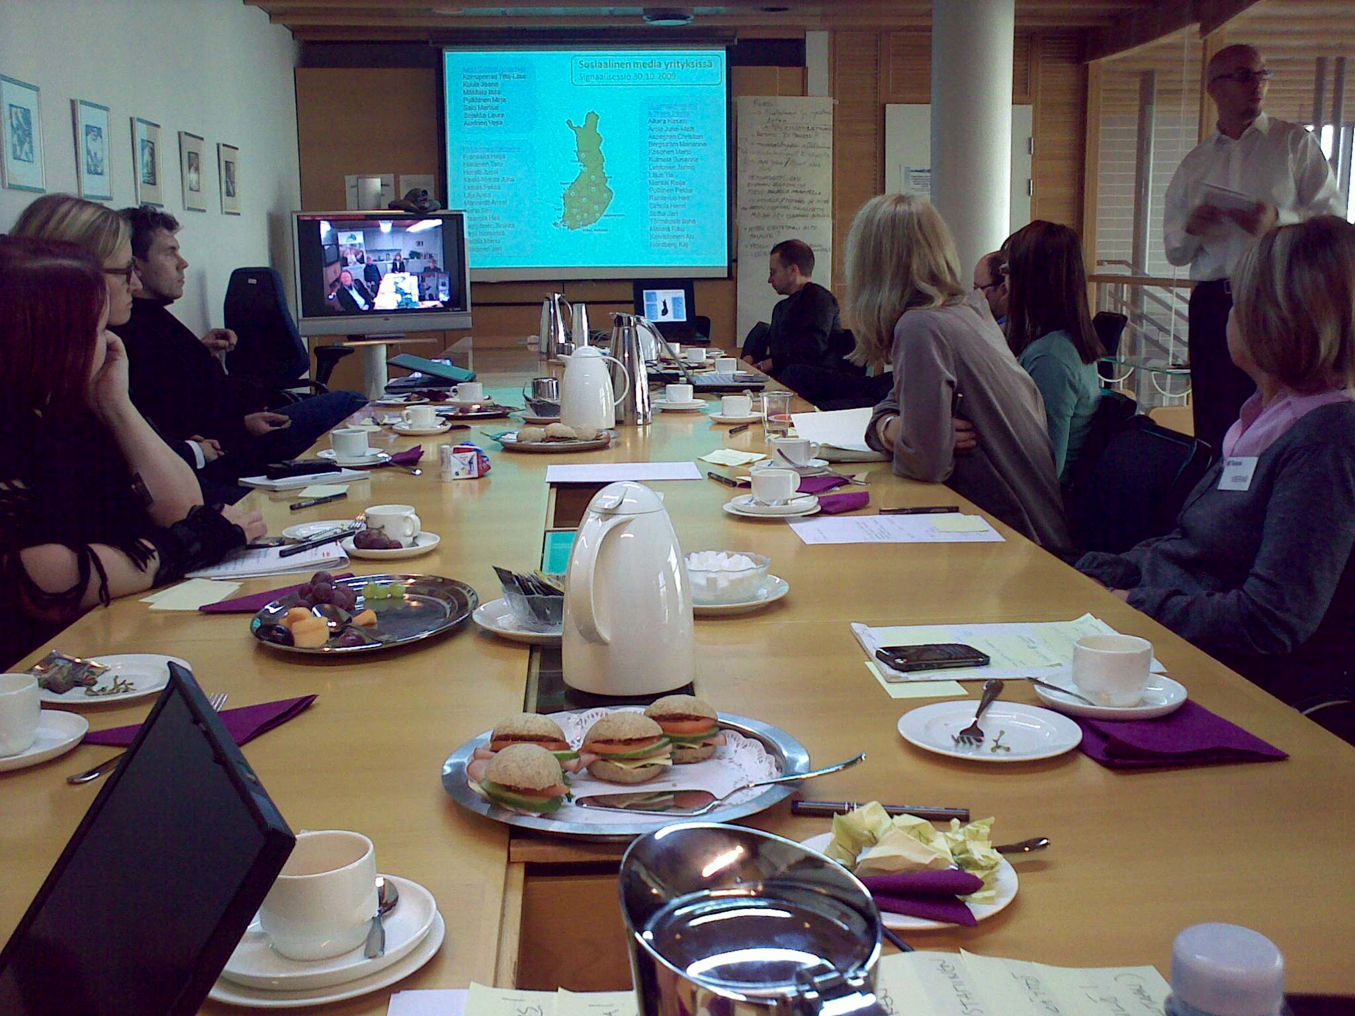

Slide 28
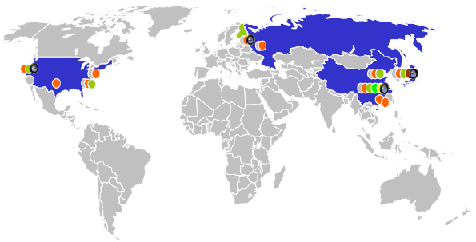




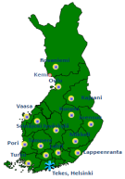
Signal sessions 2012+
Foresight information for the needs of companies
International offices
Finpro
OSKE
Choose the projects
15 Regional ELY-Centers
Foresight signals predicting changes in global markets
Remote video conference workshop with 3 cases: ideas and actions
FinPro Itävalta, Wien
Lili Lehtovuori
Pohjois-Pohjanmaa/ Oulu
Minna Tontti
Petteri Lahtela
Ritva Heikkinen
Kainuu/Kajaani
Kimmo Kyhälä
Leena Penttinen
Ilpo Antikainen
Veli-Matti Karppinen
Jukka Kohonen
Aki Koivistoinen
Lappi/Kemi
- Risto Mäkikyrö
Etelä-Savo/Mikkeli
- Maisa Häkkinen
Keski-Suomi /Jyväskylä
Kari Ahlbom
Pirkanmaa/Tampere
Juhani Mattila
Pertti Keskitalo
Riitta Kettunen
Lasse Pöyhönen
Sari Salo
Pohjois-Karjala/Joensuu
Mari Pykäläinen
Uusimaa/Helsinki
& Tekes Pasila
- Jari Keinänen
Tapani Lahti
Sinikka Mäki-Ullakko
Seppo Mäki-Ullakko
Piia Moilanen
Tapio Ala-Peijari
Anne Salminen
Polina Kivineimi
Riku Mäkelä
Heli Vähätiitto
Häme/Lahti
Jukka Ajo
Janne Eskola
Pekka Lerkkanen
Kalevi Gran
Nina Flaaming
Jari Ukkonen
Varsinais.Suomi/Turku
Maiju Hyvönen
Martti Huolila
Ann-Maarit Tuomi
Vesa Auvinen
Entrepreneurs

Slide 29

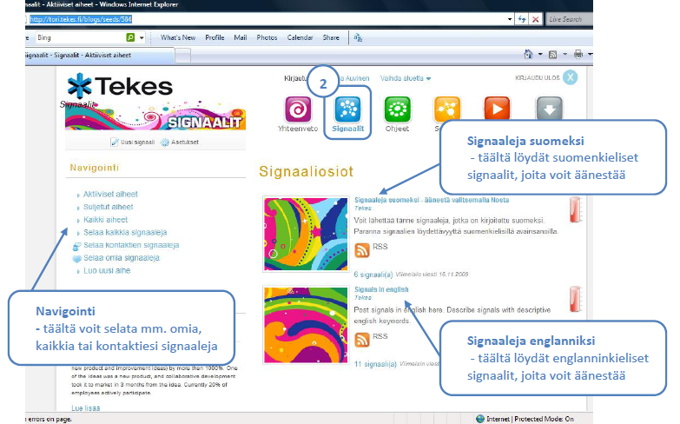
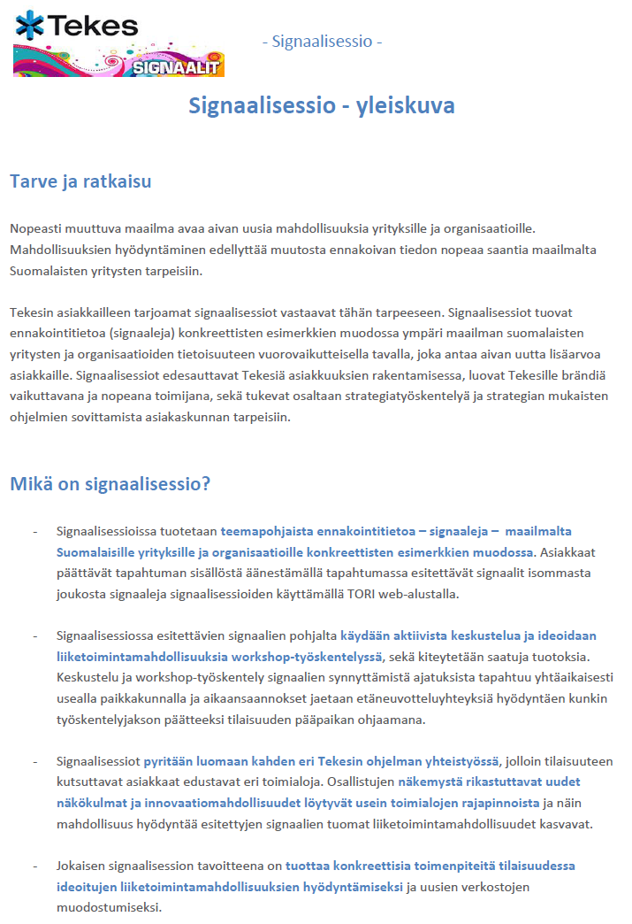
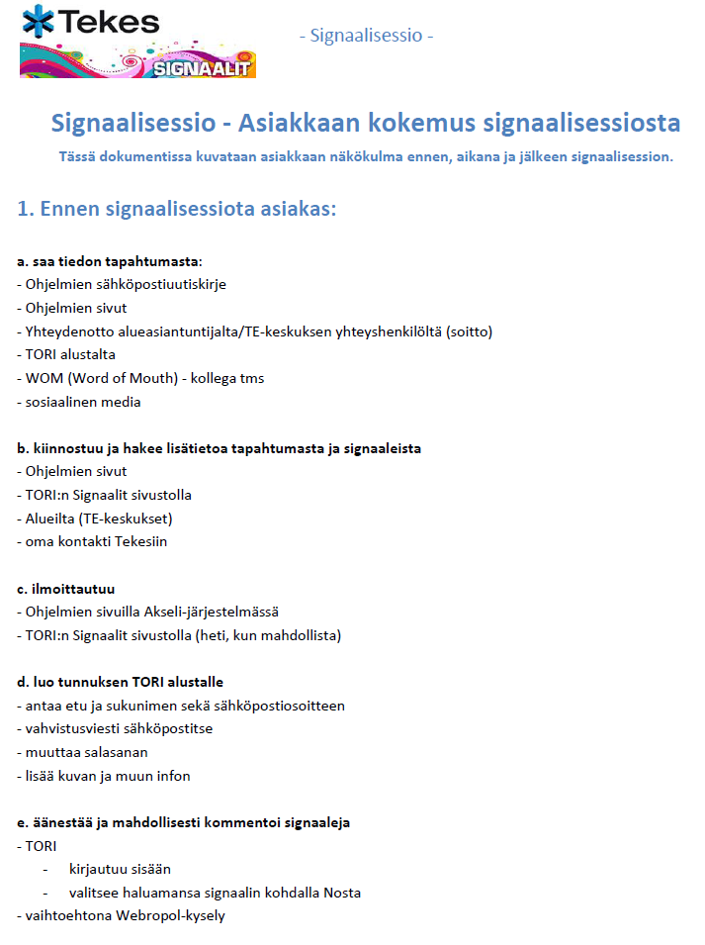
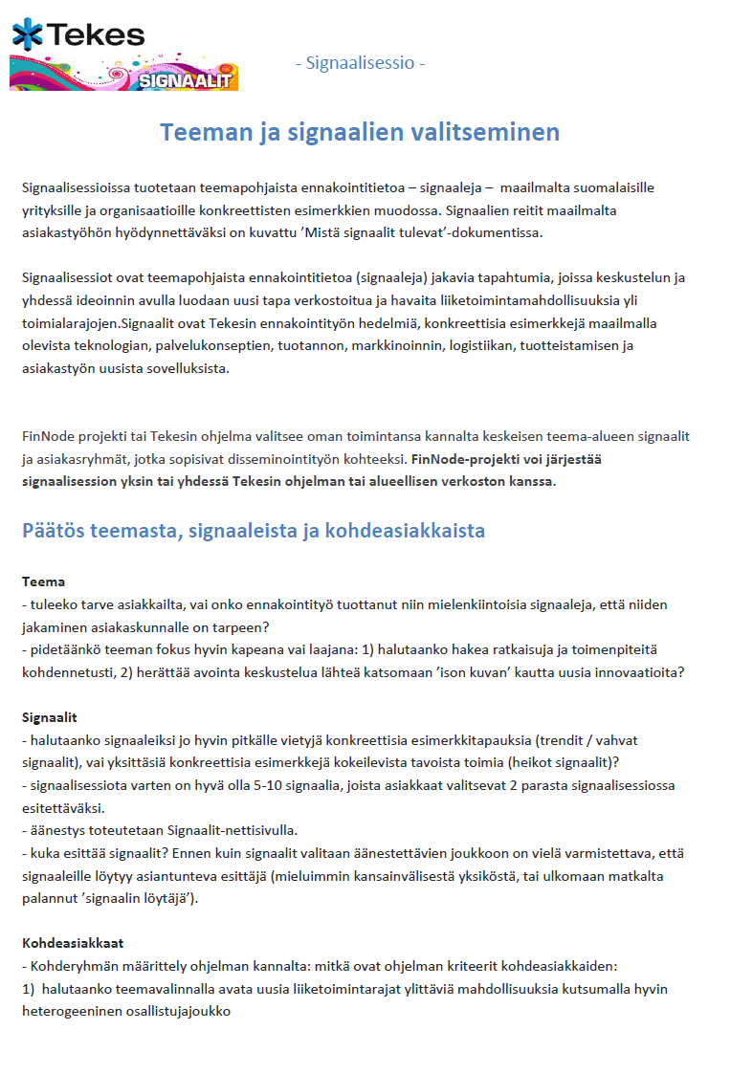
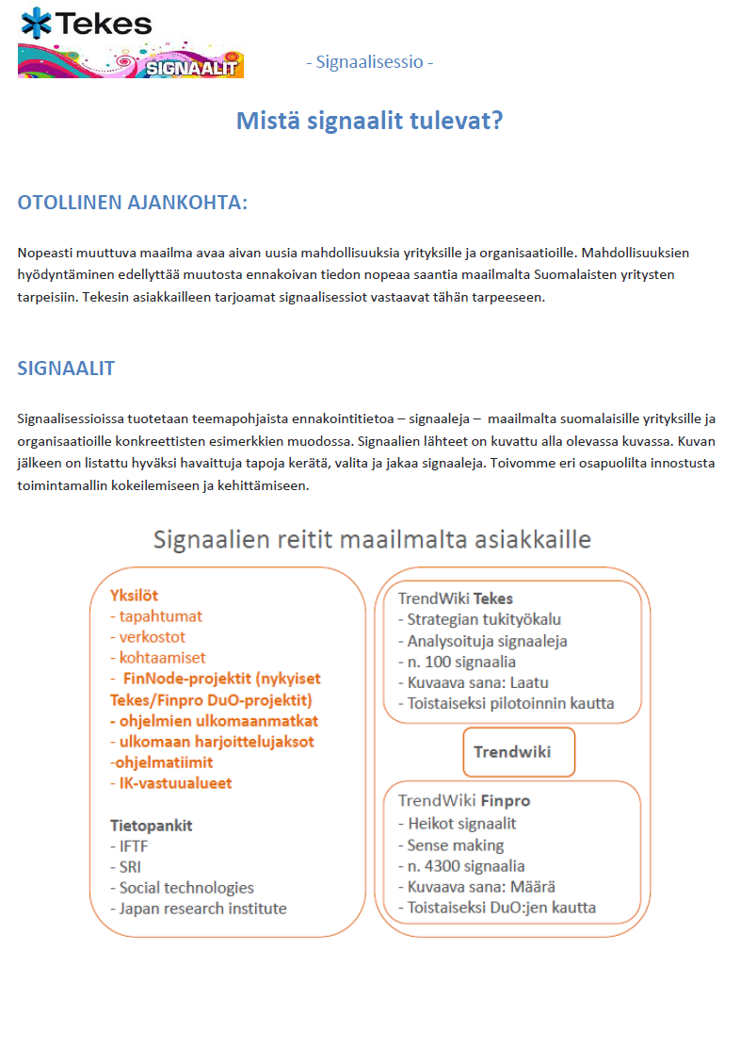
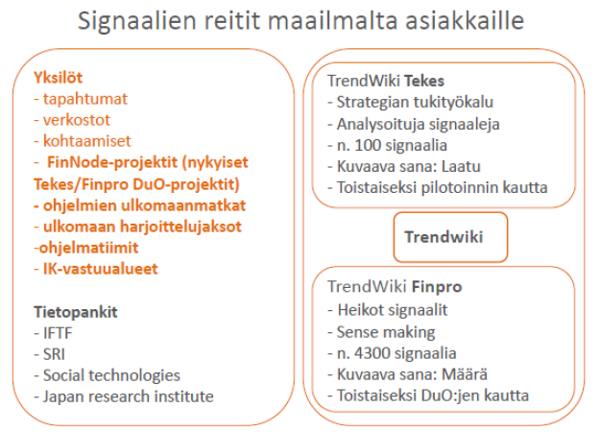
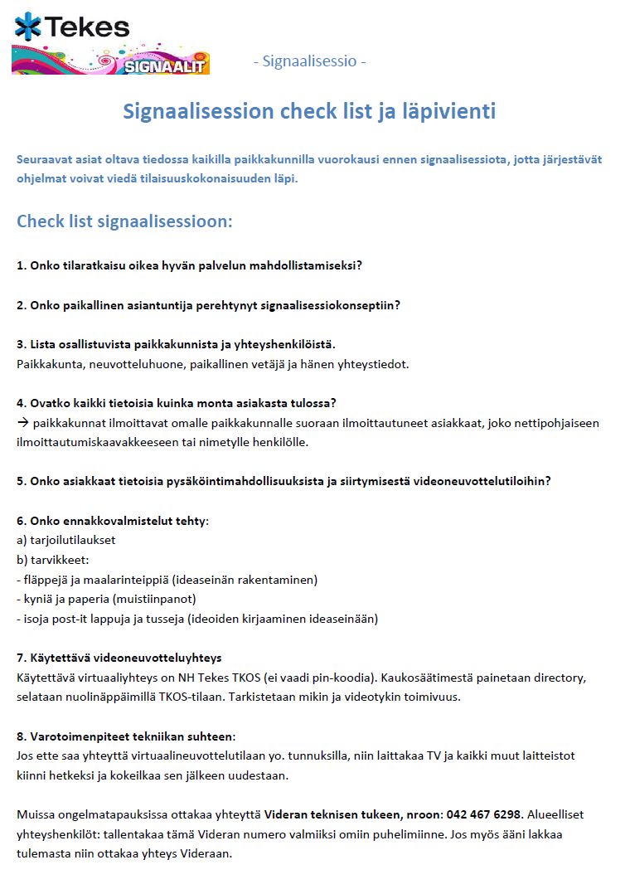
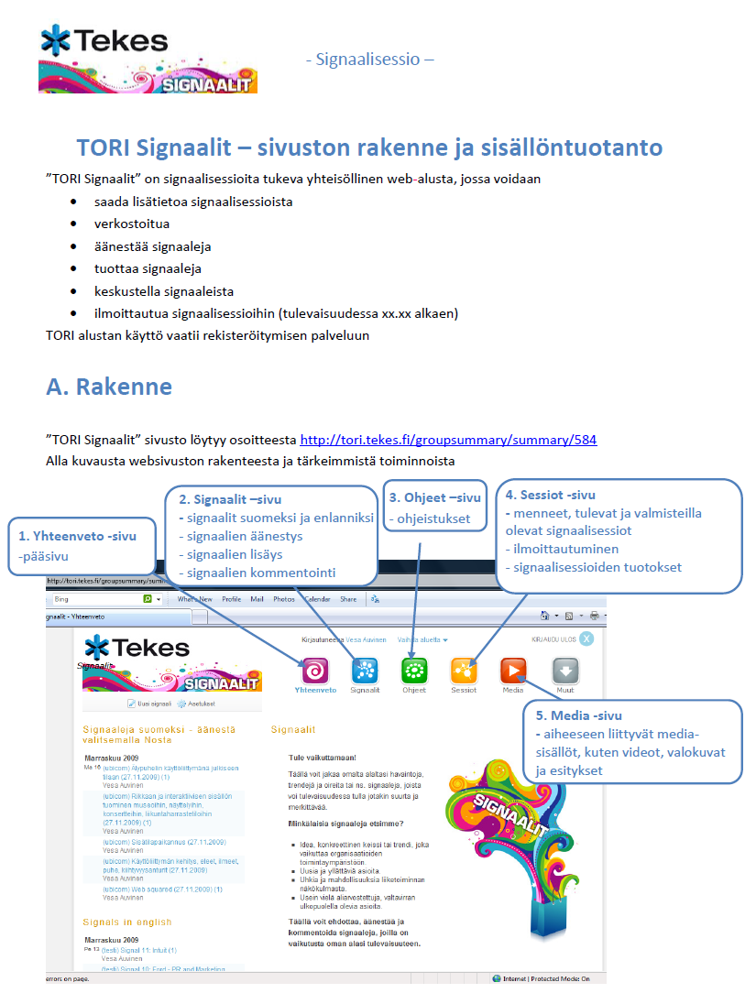
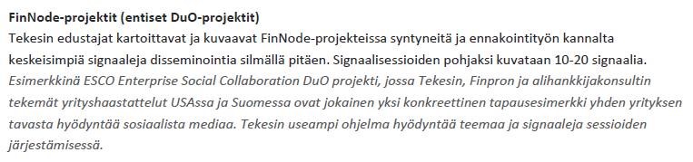
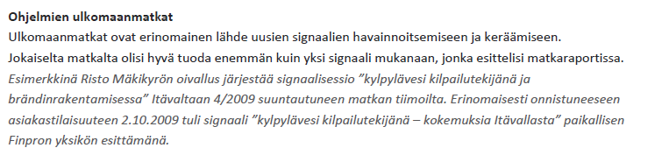
signaalit
tiedotus
materiaalit
keskustelu
opastus
ilmoittautuminen
videot

Slide 30
Signal sessions as a part of foresight system → Technology Sessions based on Technology Bank
Finpro gathering process
Signal sessions
Foresight
Insight
Strategy
Action
Tekes gathering process
New business,
Better choices
Sitra gathering process
…
…
Cases of FinNode
projects
Funding applications
Market entry
Partnering
New inititiatives
FinNode Sence Making
New ideas based
on themes
Tekes Sence Making
…
Finpro trend identification
…
Finpro services
Interaction between
FinNode projects
Tekes services
OSKE services

